Slide 1
Technical Support (420-1N6-AB) Computer Hardware: BIOS, CMOS & UEFI
Fall 2023

Slide 2
Outline
BIOS
CMOS
UEFI
Notes:
There are situation where your system needs to use the keyboard before the operating system has loaded up to the RAM.
Odds are pretty good you are going use a keyboard, mouse, storage device.
Operating systems provide device drivers. However, before even installing the operating system. That's when we need the Basic Input and Output services (BIOS) a little bit of programming built into the motherboard. They are written in a special programming language and burnt on BIOS chips.

Slide 3
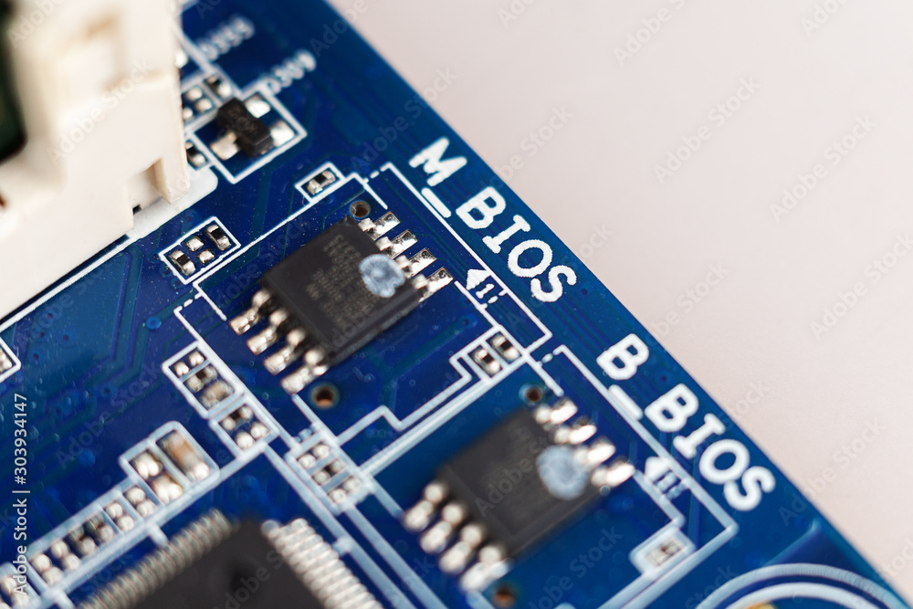
BIOS Chip
BIOS stands for Basic Input/Output services
Built-into the motherboard
Notes:
Some companies specializes in writing BIOS code and produce those BIOS chips
Common BIOS manufacturer are like AMI, American Megatrends.
Modern BIOS come in M BIOS and B BIOS (these are duplicates to provide redundance in case one breaks)
We use the word firmware which means it’s burnt on a chip as opposed to stored on the storage device.

Slide 4
Read Only Memory (ROM)
ROM chips contain instructions that are directly accessed by the CPU.
e.g. booting the computer, loading the operating system.
ROM chips retain their contents even when the computer is powered down.
Notes:
Those chips are ROM (Read-only memory)

Slide 5
ROM Types
ROM | Read only memory. Information is written to a ROM chip when it is manufactured, it cannot be erased or rewritten, now obsolete.
PROM | Programmable read only memory Information is written to a PROM chip after it is manufactured, it cannot be erased or rewritten.
EPROM | Erasable programmable read only memory Information is written to an EPROM chip after it is manufactured, can be erased with exposure to UV light using special equipment.
EEPROM | Electronically erasable programmable read only memory Information is written to an EEPROM chip after it is manufactured. Also called flash ROM. An EEPROM chip can be erased and rewritten without having to be removed from the computer.

Slide 6
What do we have so far..
Computers consist of different hardware components:
Keyboards and mice for input.
Monitors, sound cards and printers for output.
Permanent storage devices to store programs and data.
These hardware components can store/manipulate information represented by “on” and “off” states (binary, logic circuits)
The CPU communicates with all devices connected to the computer.
Chipsets allow all communication to happen.
Using Northbridge and Southbridge and the bus.

Slide 7
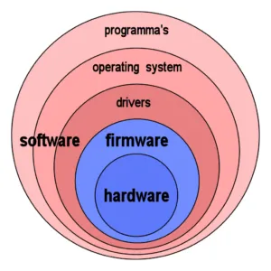
Stored in the Storage device SSD or HDD
Stored in the ROM: Read Only Memory:
Low level control.
For example: Keyboard
Source: https://www.thecrazyprogrammer.com/2021/10/difference-between-firmware-and-operating-system.html

Slide 8
CPU Meets Hardware Components
The CPU needs some program(s) loaded into memory that teaches (informs) it about a particular device so that it knows how to communicate with it. This program is known as
Basic Input/output Services (BIOS).
These programs that are dedicated to enabling the CPU to communicate with different hardware components.
Known as services or device drivers.
Firmware for the motherboard

Slide 9
CPU Meets Hardware Components (cont.)
The code to communicate with the most important hardware (keyboard, monitor, mass storage drives, optical drives, USB ports and RAM) is stored on the motherboard on a special device called a read-only memory (ROM) chip.
Remember: ROM chips are non-volatile (the information is not erased when the computer is switched off).
Modern motherboards use flash ROM whose contents can be changed through a process called “flashing the ROM”.

Slide 10
CPU Meets Hardware Components (cont.)
Every motherboard has a flash ROM chip called the “system ROM chip” containing code that enables the CPU to talk to the basic hardware of your PC.
These services are collectively called the “System BIOS”.
The system BIOS supports all the hardware that never changes (e.g. keyboard controller, PC speaker that beeps at you) by storing the BIOS for these devices.
Note: programs stored on ROM chips are referred to as firmware.
Firmware: the software that directly controls computer hardware, below the level of the Operating System

Slide 11
So What is System BIOS?
In summary, BIOS:
Basic Input/Output System
Known as system BIOS, ROM BIOS, or PC BIOS.
Firmware embedded on a non-volatile chip on the computer's motherboard.
Pre-installed on the motherboard by the manufacturer.

Slide 12
How does BIOS work?
Computer starts up
BIOS loads into memory
BIOS wakes up the computer’s hardware components
BIOS performs a Power-On-Self-Test (POST) to make sure that all connected hardware components are working properly.
BIOS looks for a boot loader on the storage device to initialize the installed operating system.
Notes:
The BIOS can’t be really be studied from a programming perspective since it’s very different from one manufacturer to another.
But one thing we can do to study the BIOS is to understand what it can do and how to use it.
For example, on the BIOS you can talk to a storage device without even loading windows. The reason behind this, is we need to make sure that the hardware components are all functional before even loading the OS.

Slide 13
Power-On-Self-Test (POST)
If the computer passes the POST, the internal speaker will make a short single beep indicating that the computer has passed the test and is booting up normally
If there are no beeps or multiple beeps, this indicated that the computer has failed POST.
There is an error and further troubleshooting is required to find out what is the problem.
The computer will generate a beep code to help you pinpoint the problem.
Examples:
Three long beeps could indicate a keyboard error.
A continuous short beep could indicate a problem with a RAM module.
Always refer to the motherboard manufacturers’ documentation to examine a list of beep codes and what they indicate to be able to pinpoint the problem and correct it
Every computer and manufacturer will have a different standard for what each beep code means.
Notes:
The Power-On-Self-Test.
Have you ever noticed that there’s no “Run” button on a computer, sure there’s an on/off button that provides electricity to the motherboard.
There must be an instruction that tells the CPU start running? That’s done by the CPU itself by a wire called the Power-good wire built-into the CPU, once it receives enough voltage it starts running and then run the POST (Power on self test) which is on the BIOS chip.
The Power on self test is a simple program, where every instruction will verify every controller on the motherboard (RAM, Storage device controllers, USB Controllers, whatever controllers your motherboard supports will be checked.
Have you ever heard those beeps sounds coming out of a computer that boots up? Especially if it has a problem?
The beep sound is a code for a specific error. Beep (can’t find RAM), refer to the manufacturer datasheet for that. There’s a little speaker inside the computer that beeps during the POST.
Now do you remember this little POST card that we saw in the Hardware Mystery game?
This is a card used exactly for this purpose, when you are building a computer and may not have plugged the monitor yet and want to verify if your system unit is correctly assembled.
You can use this little POST card.
All post cards display errors in Hexadecimal

Slide 14
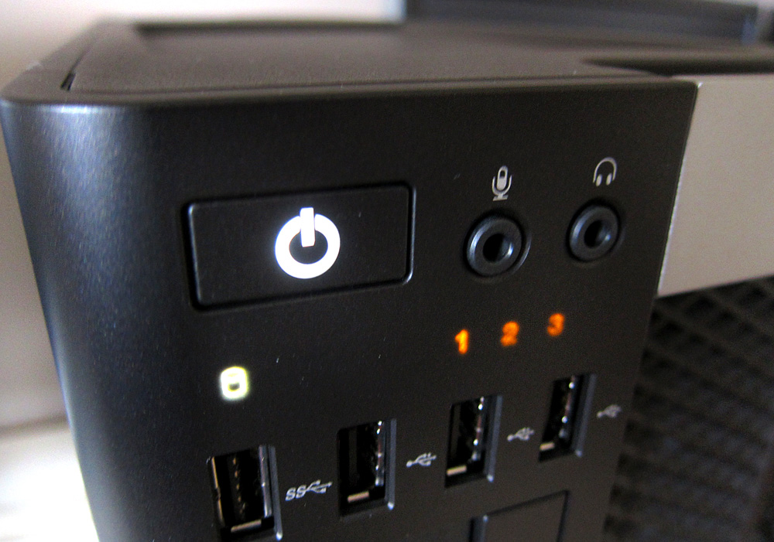
Activity - POST Error code – Optiplex 990
On some PCs such as the Dell OptiPlex series, there exists up to 4 LED lights on the front panel which light up during the POST test and indicate error codes if an error occurs.
Search online for this error “1”, “2” , “3”. Note the power button is on.
Assume this is a picture of the OptiPlex 990.
Notes:
https://f5k.fandom.com/wiki/Front_Panel_Lights_-_Optiplex_990
If power button is on: There’s a possible coin cell battery error
If power button is off:

Slide 15
CompTIA + - troubleshooting steps
Identify the problem
Establish a theory of probable cause
Test the theory to determine the cause
Establish a plan of action to resolve the problem and implement the solution
Verify full system functionality, and if applicable, implement preventive measures
Document findings, actions and outcomes.

Slide 16
Activity – OptiPlex 3020 – Beeping and Blinking
In pair of two, can you try to:
Identify the problem
Establish a theory of probable cause
Test the theory to determine the cause
Establish a plan of action to resolve the problem and implement the solution
Verify full system functionality, and if applicable, implement preventive measures
Document findings, actions and outcomes.

Slide 17
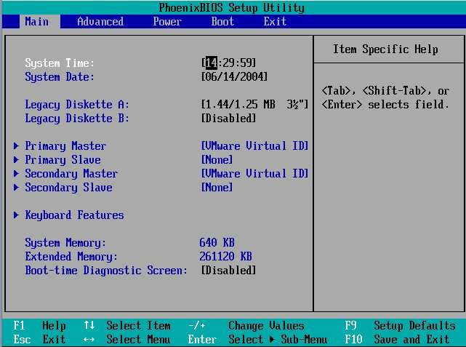
BIOS Settings
After the computer is turned off, it needs to maintain certain settings such as:
Date and time
Boot sequence
Certain hardware settings
Many important custom settings can only be configured in the BIOS.
These settings are stored on another chip on the motherboard (CMOS)
Notes:
Another thing that’s part of the BIOS, is the System Setup

Slide 18
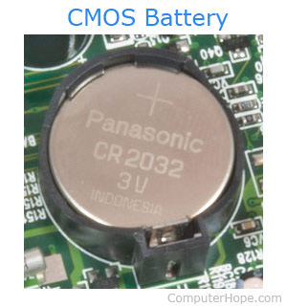
CMOS
A separate memory chip called CMOS (complementary metal-oxide semiconductor) that stores the information that describes specific device parameters.
CMOS also acts as a clock to store the current date and time.
CMOS is the semiconductor technology used in the transistors.
Made of silicon and germanium which conduct electricity but only under certain controllable conditions (semiconductor).
CMOS is usually powered by a coin-sized CR2032 cell battery, referred to as the CMOS battery.
Most CMOS batteries will last the lifetime of a motherboard, up to 10 years in most cases, but will sometimes need to be replaced.
Incorrect or slow system date and time or loss of BIOS settings are signs of a dead or dying CMOS battery.
Notes:
The system setup is located on a memory chip called CMOS (complementary metal-oxide semiconductor).
BIOS is designed to talk to our assumed hardware (but this hardware can change ex: different harddrives, different usbs, etc.), maybe new security updates will change how the hardware is interacted with.
The system setup is an interface that we get to on our computers and make changes to (part of the BIOS that can actually change).
To get to the BIOS changeable part, you need to hold a key. F2 or F3 keys.

Slide 19
CMOS (cont.)
Initially the CMOS was a separate chip on the motherboard.
Nowadays it is almost always built into the Southbridge.
The information stored in CMOS is vital for the computer to function.
Every computer ships with a program that allows you to access and modify CMOS data.
CMOS can be accessed at computer boot by pressing a special key (depends on the manufacturer)
Usually it would be F1, F2, F10, F12, Del or a key combination -- again, it will be different for every manufacturer

Slide 20
CMOS
Use almost no power when not needed but can become very hot when in use. (This limits their speed significantly.)

Slide 21
Activity – Open the System Setup
Restart your PCs
Hold the F2 keys while it is restarting.

Slide 22
Common CMOS Options
System date/time | Set the system date and time.
Boot sequence | The order that BIOS will try to load the operating system.
Plug and play | A standard for auto-detecting connected devices.
Mouse / keyboard | Settings to enable number lock, auto-detect the mouse, etc.
Drive configuration | Configure hard drives, CD-ROM and floppy drives.
Security | Set a password for accessing the computer
Power management | Select whether to use power management, as well as the amount of time for standby and suspend.

Slide 23
BIOS Limitations
BIOS was the only firmware service of its kind for a long time. (Early MS Dos computers in 1980 had BIOS.)
BIOS had several limitations:
Each motherboard manufacturer had to produce their own BIOS. (customised to at particular set of hardware components).
Must run in 16-bit processor mode and only has 1 MB of space to execute in.
Has trouble initializing multiple hardware devices at once, which leads to a slower boot process when initializing all the hardware interfaces and devices on a modern computers.
Can only boot from drives of 2.1 TB or less.
Can only support keyboard access.

Slide 24
BIOS Limitations
Everything in a computer has been improving over the past decades: Connectivity, CPU, RAM, Storage devices,etc
Except! The BIOS which remained a 16 bits for decades.
In the past decade, the BIOS was replaced with the UEF-BIOS or just UEFI

Slide 25
BIOS Replacement
Intel developed the Extensible Framework Interface (EFI) - an open system of standards for developing firmware for hardware components.
Without the entire framework needing to be architecture specific.
This grew into UEFI (Unified Extensible Framework Interface), which is maintained by a group of technology companies including Apple, Microsoft, IBM and Intel.

Slide 26
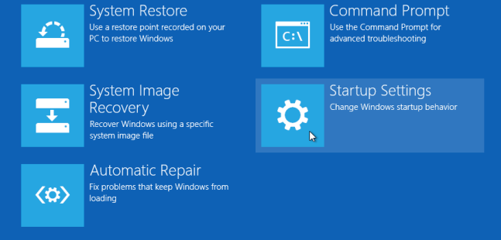
UEFI
UEFI is a customizable framework which does not require a separate program (boot loader) to launch the operating system.
UEFI Includes native support for HDDs larger than 2 terabytes.
UEFI has user-friendly graphical user interface that supports different colors and even animations with mouse support.
UEFI also has a built-in feature called secure boot.
Secure boot stops any digitally unsigned drivers from loading.
Helps to stop malicious software such as rootkits.
OS Support:
Windows 8 and newer PCs use UEFI instead of BIOS.
Apple MAC has used UEFI for years.
Linux doesn’t have a dedicated hardware manufacturer, so Linux users have used whatever they want for years! Mostly UEFI but there are some alternatives

Slide 27
Activity – OptiPlex 3020 - Power ON and OFF
Is this happening before or during POST?
Notes:
The easiest quick fix is to clear cmos settings via motherboard jumper RTCRST. I think these pc have a dying cmos battery which cannot hold nonvolatile memory well. The battery may not be quite dead but is getting old thus the rom is losing memory kind of like getting demented. If clear cmos fixes problem, replace cmos battery with a brand new one at your earliest convenience.
Identify the problem: Computer unable to start due an unknown error. The computer keeps power ON and OFF while beeping. The POST Diagnostic card indicates no error code which indicate that the problem might be happening before the Power-on-self-test.
Plausible theory: based on similar issues found online, the plausible cause of this is a dying CMOS battery preventing the CMOS to hold nonvolatile memory. The fix is to clear the CMOS via the RTCRST jumper. Eventually the CMOS battery needs to be replaced.
Implementing the solution: ….
Validating: ………

Slide 28
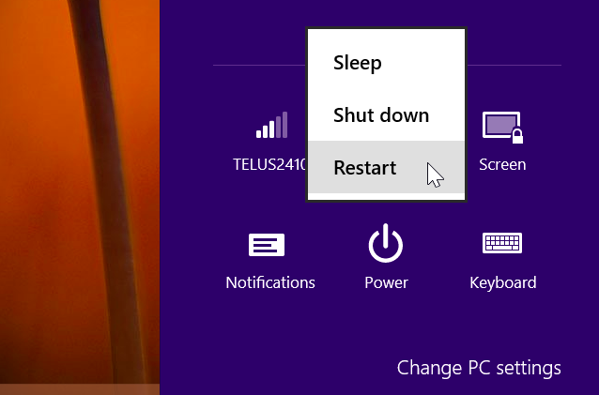
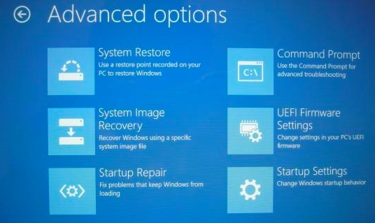
How To Access UEFI Settings
Windows 10 & 8:
Hold down Shift when restarting.
Settings → Update and Security → Recovery → Advanced Startup.
In command prompt, type
shutdown.exe /r /o
Click “UEFI Firmware Settings” to access firmware options (like BIOS).

Slide 29
Q & A
Notes:
In Slide Show mode, click the arrow to enter the PowerPoint Getting Started Center.

